Slide 1
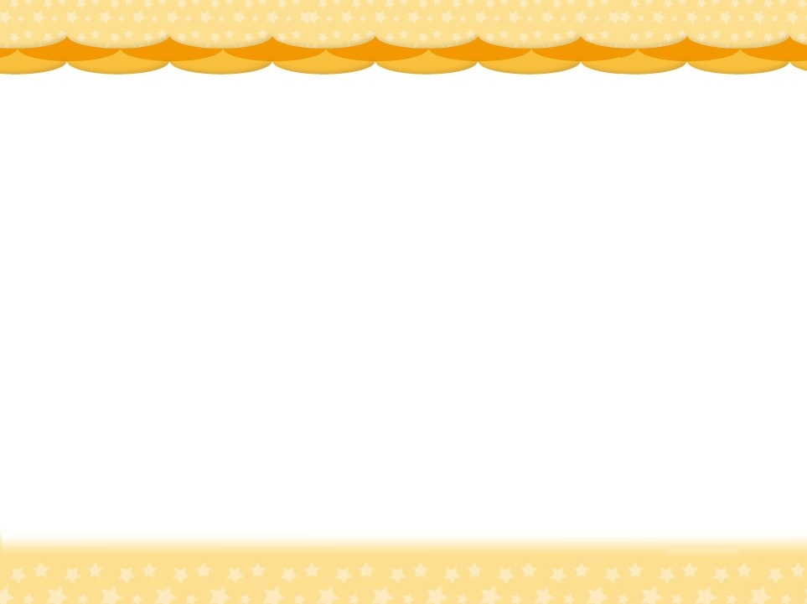
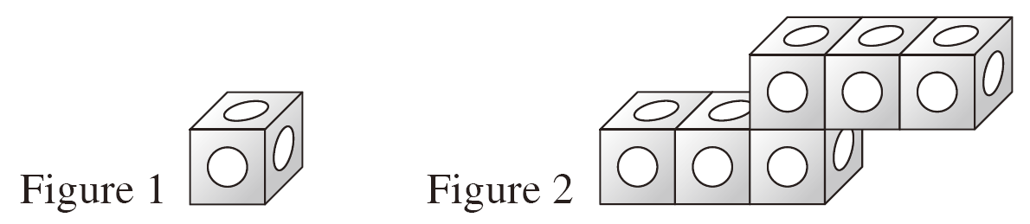
Revision 8 3-D shapes
Count the overlapped faces.
7
8
9
10
1
2
3
4
5 6
6 cubes
3. The cube in Figure 1 has a pattern on each face. Several cubes are glued together to form the
solid in Figure 2. How many patterns are there
on the surface of it?
A. 15 B. 16
C. 26 D. 36
Each cube has 6 faces.
Find the number of faces in total.
Subtract the number of overlapped faces from the total.

