Slide 1
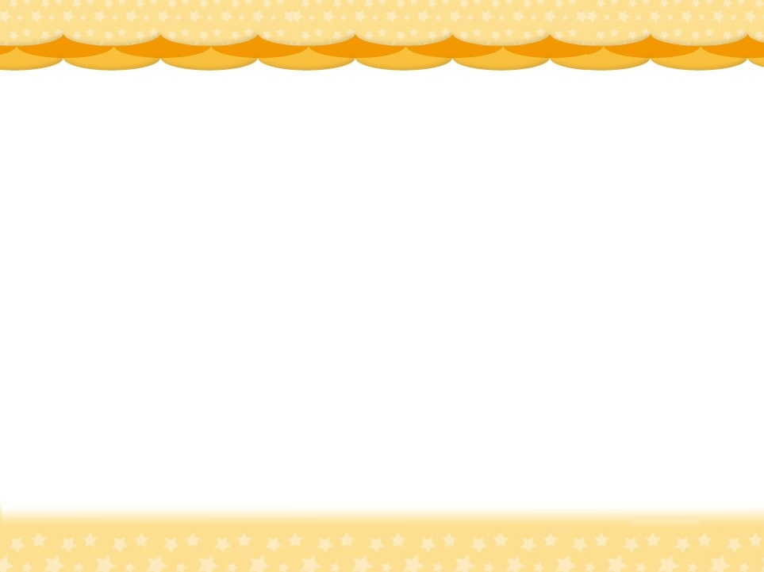
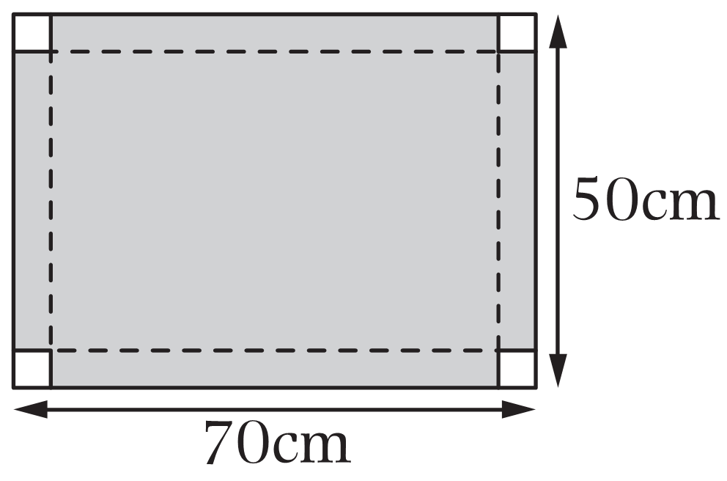
Revision 10 Volume
5cm
5cm
1. Draw the box
3.
A piece of rectangular cardboard is 70cm long and 50cm wide. A square of side 5cm is cut out from each
of the four corners of the cardboard, as shown on the
right. If the cardboard is folded along the dotted lines
to make a box with a lid, what is the volume of the box?
5cm
2. Find the length and width of the box.
The height of the box is equal to the
length of side of the cut-out square.
5cm
5cm
Find the length after cut.
The height is 5cm.
A. 12000cm³ B. 14000cm³
C. 14625cm³ D. 17500cm³
Find the volume of the box.
Find the width after cut.

