Slide 1
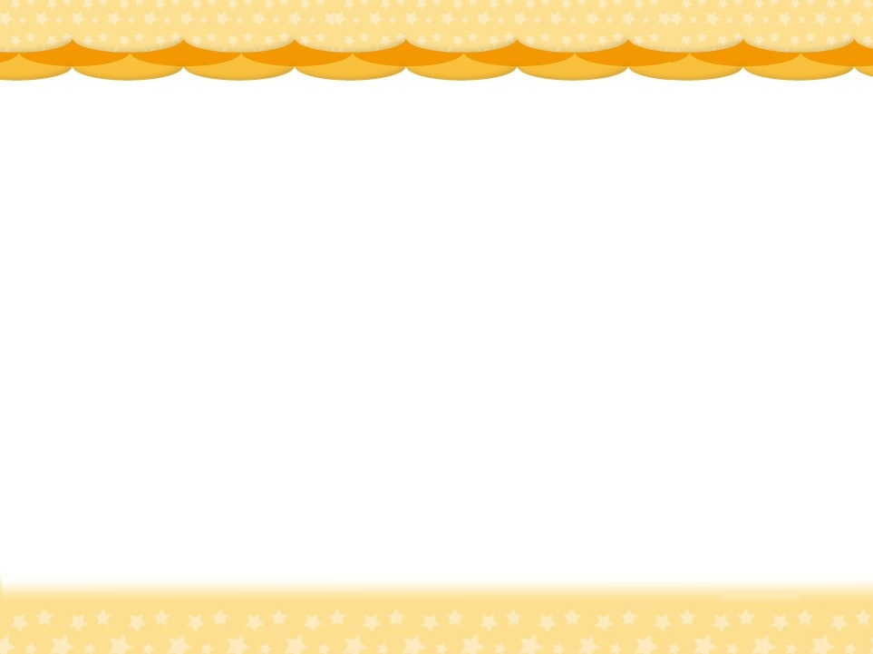
Revision 11 Algebraic expressions and simple equations
2. Yoyo bought 8 dozen of sketch papers. She will
use N sketch papers for drawing each day. How
many sketch papers will be left after 3 weeks?
A. 106－ 21N B. 96－ 21N
C. 8－ 21N D. 8－ 3N
Hint
1. Find the total number of sketch papers first.
2. Find the number of sketch papers used in 3 weeks.

