Slide 1

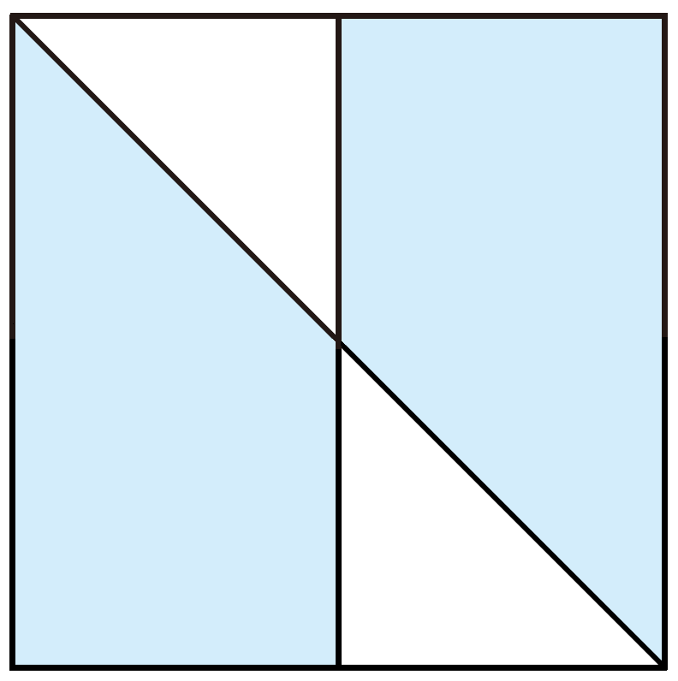
Unit 3 Fractions, decimals and percentages
5. The figure on the right is a square.
What percentage of the figure is
coloured?
A. % B. %
C. 25% D. 75%
1
4
3
4
Hint
According to the distribution of
the coloured part, divide the
square into several equal parts.

