Slide 1

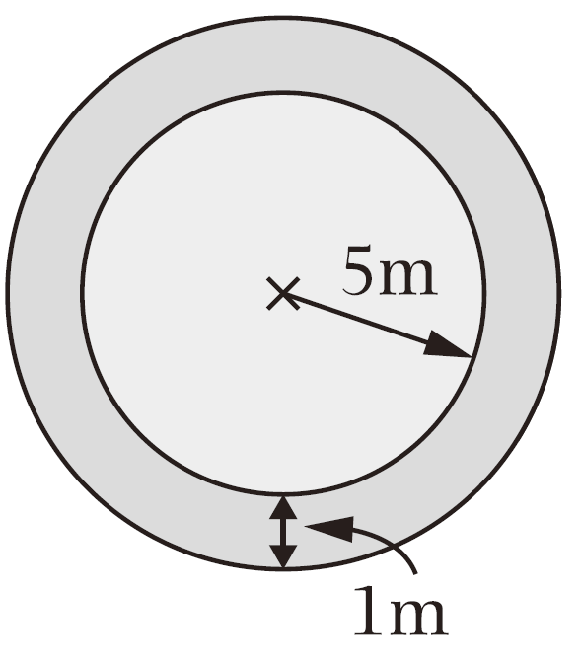
Unit 7 Circumference and area of circles
7. Around a circle pool of radius 5m,
there is a footpath of 1m wide.
(Take π as 3.14)
5m
(5＋1)m
(a) What is the area of the footpath?
【4 marks】
The area of the
footpath
Find the area of the large circle.
Subtract the area of the small circle from the large one.
Find the area of the small circle.

Slide 2
Unit 7 Circumference and area of circles
7. Around a circle pool of radius 5m,
there is a footpath of 1m wide.
(Take π as 3.14)
(b) Fence will be built along the two
sides of the footpath. The cost of
building the fence is $200 per
metre. What is the total cost?
(Give the answer only) 【2 marks】
Hint
Pay attention to the
word “two sides”.
13816
Answer: $ .
Find the total length of the two sides of footpath.
Find the circumference of the large circle.
Find the total cost.
Find the circumference of the small circle.

