Slide 1
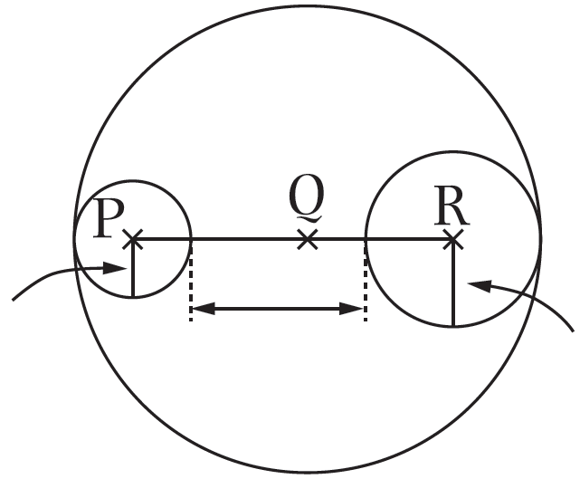
Unit 9 Circles
4.
Hint
Find the diameter of the
largest circle first.
2cm
6cm
3cm
In the above figure, P, Q and R are centres of three circles. These three points lie on the same straight line. What is the radius of the largest circle?
A. 8cm
B. 10cm
C. 16cm
D. 18cm
Diameter of the largest circle = Diameter of the smallest circle ＋6cm ＋ Diameter of the medium circle

