Slide 1
Unit 16 Volume
6.
(a)
120 people participated in an environmental protection activity. Among the participants,
were children, were elderly and the rest were teenagers and adults. How many
teenagers and adults were there altogether? (Give the answer only) 【2 marks】
1
1
10
8
120 people
children
elderly
teenagers and adults
1
1
？people
10
8

Slide 2
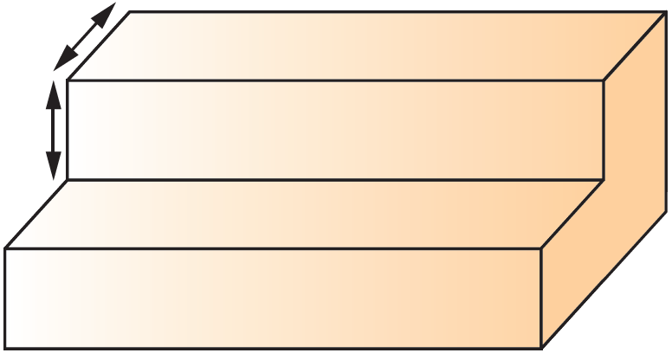
Unit 16 Volume
6.
6m
0.4m
0.3m
(b)
There was a stand of 6m long in the event venue. Each step of the stand had the same width and same height. What is the volume of the stand? (Give the answer only)【2 marks】
The stand can be divided into three small cuboids of the same size and the same shape.
Volume of the stand
= Volume of a small cuboids3

