Slide 1

Normal strip
Step 1 Make normal strip

Slide 2
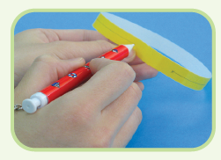
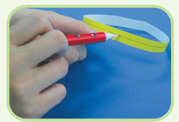
Normal strip
Step 2 Draw a line along the normal strip on either side
Result : The line drawn only stays in the inside or outside
the normal strip.

Slide 3
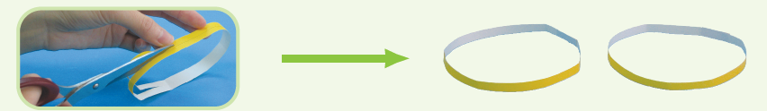
Normal strip
Step 3 Cut the normal strip along the line that you have
drawn.
Result :
The normal strip is split into two smaller strips.

Slide 4
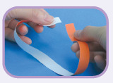

Mobius strip
Step 1 Make mobius strip
Twist and forma circle.

Slide 5
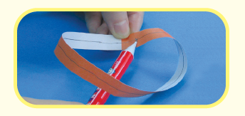
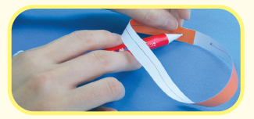
Mobius strip
Step 2 Draw a line along the Mobius strip on either side
Result : The line drawn can travel the whole Mobius strip,
which means that Mobius strip has only one face.

Slide 6

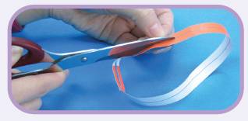
Mobius strip
Step 3 Cut the Mobius strip along the line that you have
drawn.
Result :
The Mobius strip becomes a twisted larger circular strip.

